Slide 1
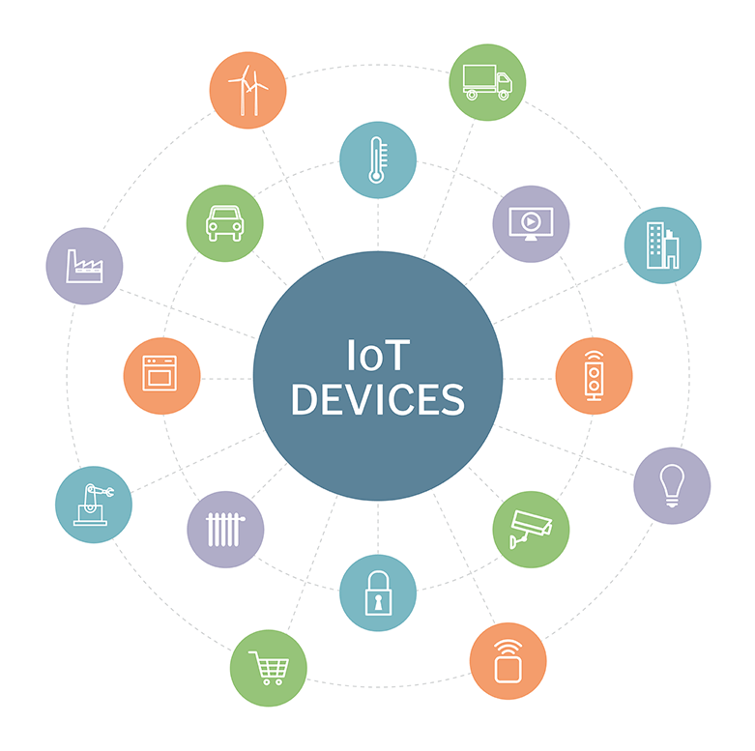
Bonrix IOT M2M Remote Monitoring Solutions
Bonrix Software Systems
http://www.bonrix.net/
http://www.bonrix.co.in/ http://iot.bonrix.in/

Slide 2
IOT Devices
The Internet of things (IoT) is the extension of Internet connectivity into physical devices and everyday objects.
Embedded with electronics, Internet connectivity, and other forms of hardware
(such as sensors), these devices can communicate and interact with others over
the Internet, and they can be remotely monitored and controlled.

Slide 3
Types Of IoT Devices
Home Automation IoT Devices.
Industrial IoT Devices.
Miscellaneous IoT Devices.
Development Boards IoT Devices.
Virtual Reality (VR) and Augmented Reality (AR) IoT Devices.

Slide 4
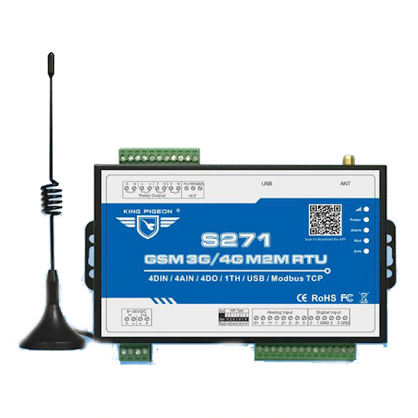
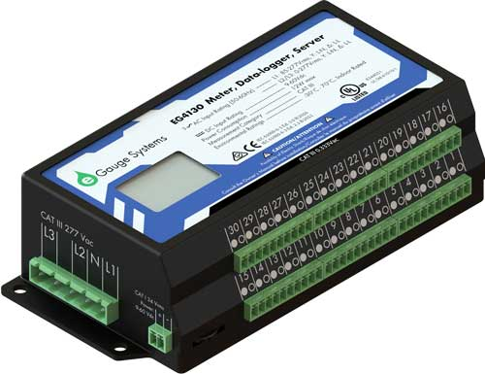
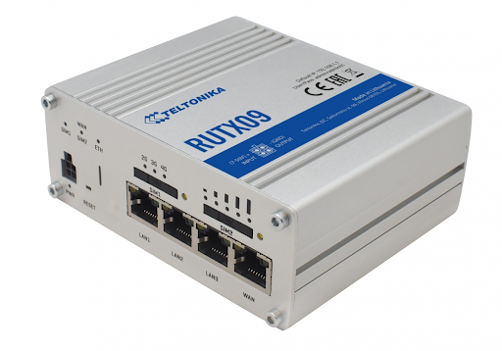
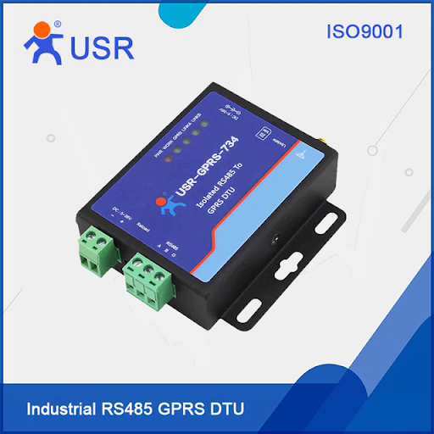
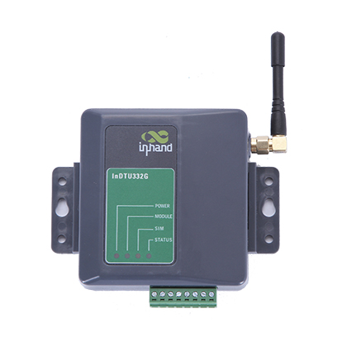
IOT M2M Devices
eGaugePro
RUTX09
GSM_S-271
GPRS_RS4855
DTU332G
SS-8 Modbus

Slide 5
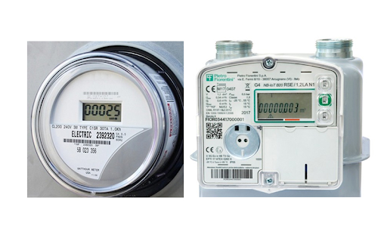
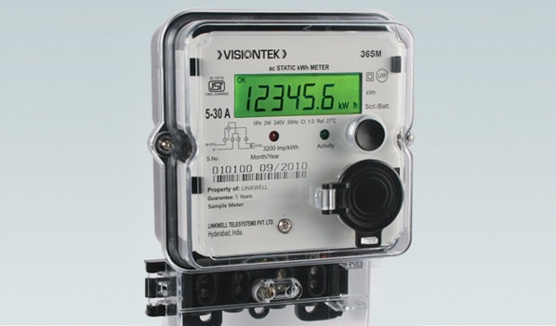
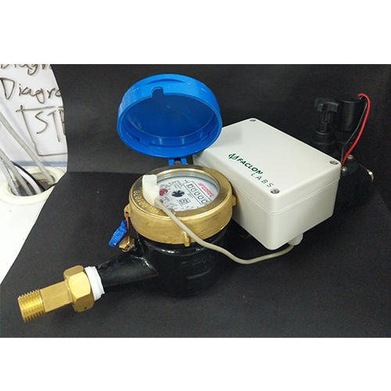
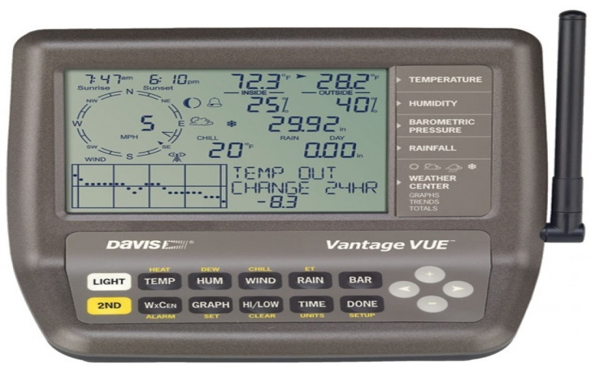
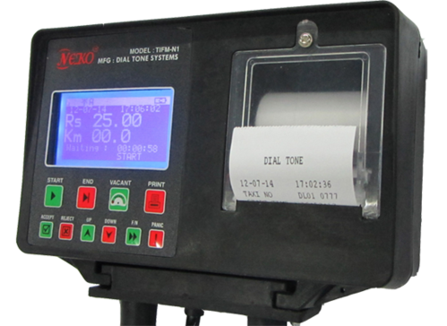
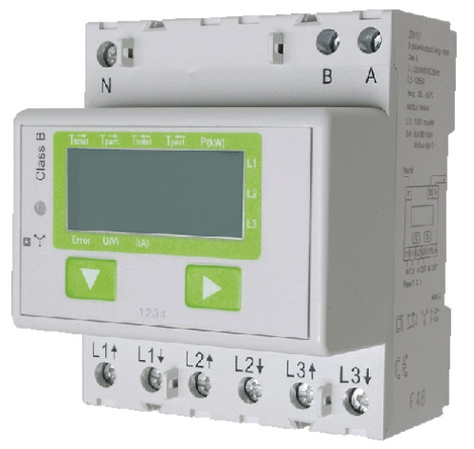
IOT M2M GSM Meter
Gas Meter
Energy Meter
Smart Water Meter
Weather Station IOT Meter
Taxi Meter
Solar Meter

Slide 6
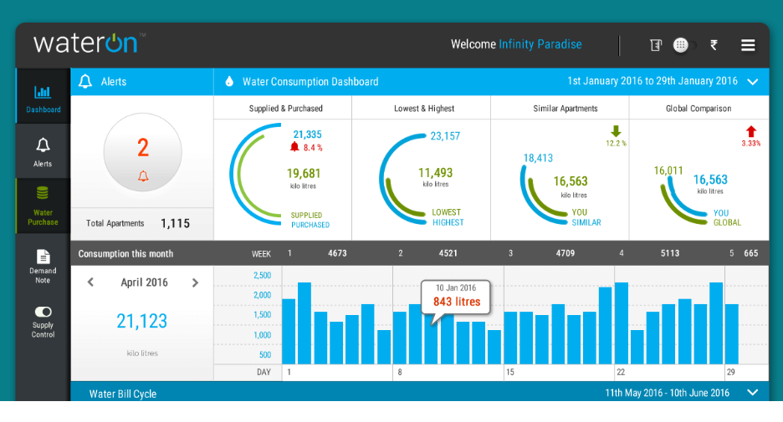
IOT M2M Dashboard

Slide 7
Applications Of IoT Devices
Energy Monitoring.
Solar Monitoring.
Environment Monitoring.
Smart Grid.
Cold-Storage.
Generator.
Street Light.
Water Treatment.

Slide 8
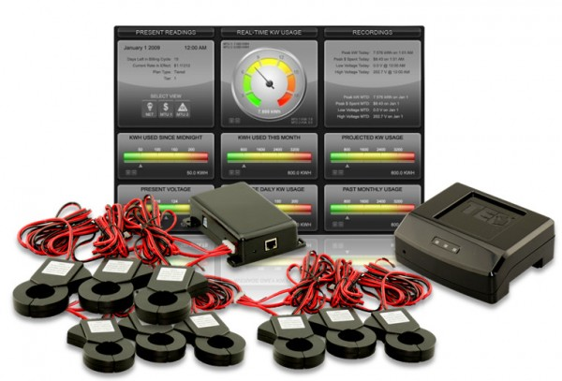
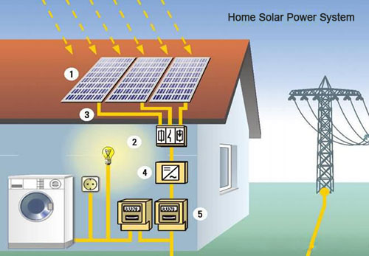
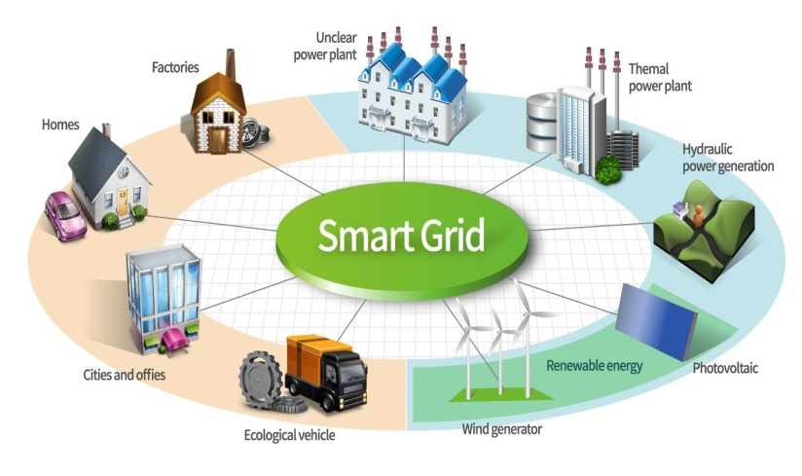
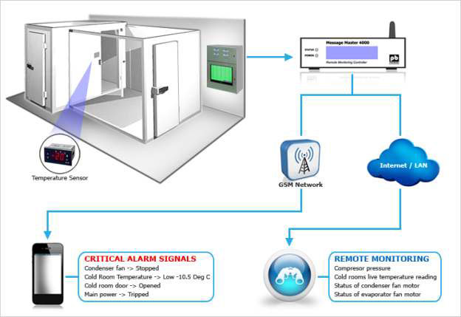
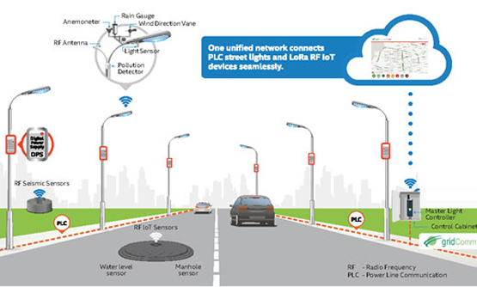
Applications Of IoT Devices
Energy Monitoring
Solar Monitoring
Energy Monitoring
Smart Grid Monitoring
Cold Storage Monitoring
Street Light Monitoring

Slide 9
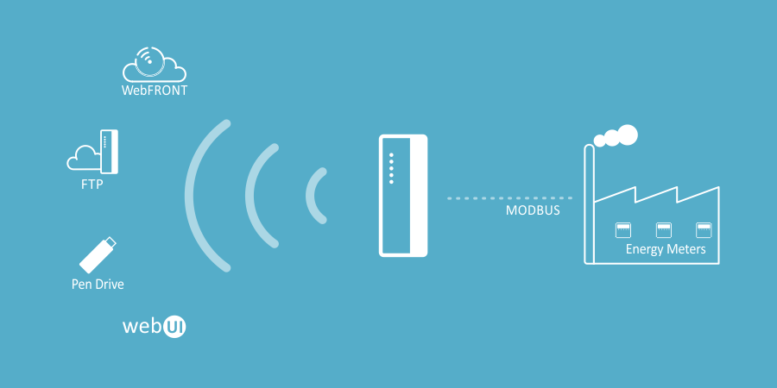
Energy Monitoring
How it works?
Install data-logger to remotely collect key energy metrics.IoT Cloud platform for data-aggregation. Advanced Analytics to identify energy usage patterns.Design efficient power policy and optimize energy usage.

Slide 10
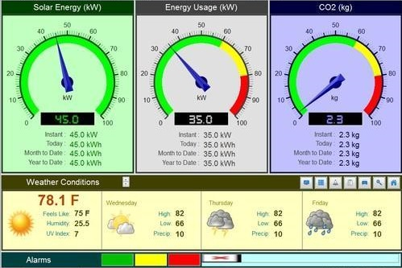
Solar Monitoring
How it works?
Install data-logger with Inverters, Weather Station and SCBs.
IoT Cloud platform for data-aggregation.
Dashboards & Analytics reports for energy management.

Slide 11
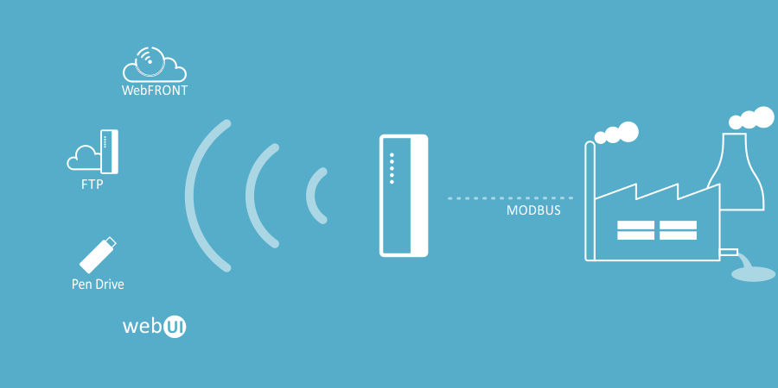
Environment Monitoring
How it works?
Install data-logger to remotely collect analyzer data.IoT Cloud platform for data-aggregation. Dashboards & Analytical reports. SMS/Email alerts for any unusual spike.

Slide 12
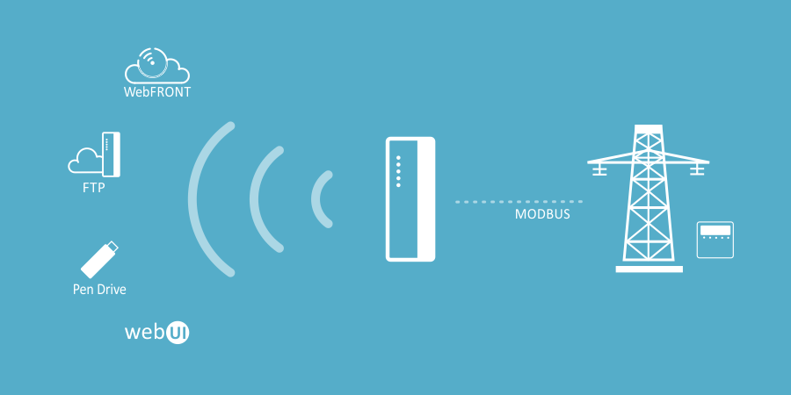
Smart Grid
How it works?
Install data-logger to remotely collect Energy Consumption. IoT Cloud platform for data-aggregation through installed Energy Meter. Dashboards & Analytical reports for Energy Consumptions. SMS/Email alerts for Load shedding. Switch ON/OFF using Cloud by just one click. Receive an alarm notification when Power consumption reaches over load level.

Slide 13
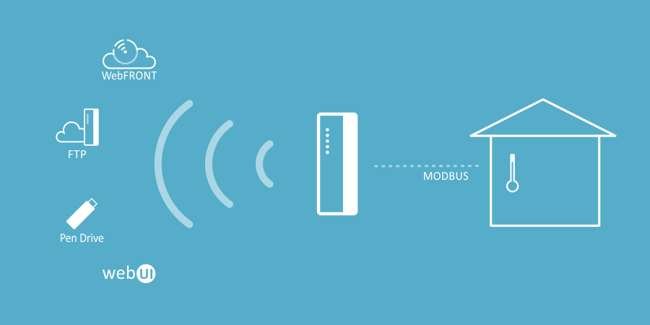
Cold Storage Monitoring
How it works?
Install field sensors & data-logger to remotely collect temperature readings. Record Energy and Diesel Generator usage. IoT Cloud platform for data-aggregation.Dashboards & Analytical reports to provide holistic temperature profile for the facility. SMS/Email alerts for any surge in temperature.

Slide 14
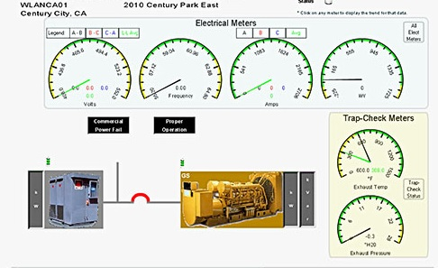
Generator Monitoring
How it works?
Install data-logger and sensors to remotely monitor generator metrics.IoT Cloud platform for data-aggregation.Dashboards & Analytical reports.SMS/Email alerts for any malfunction or theft. Maintainance alerts.

Slide 15
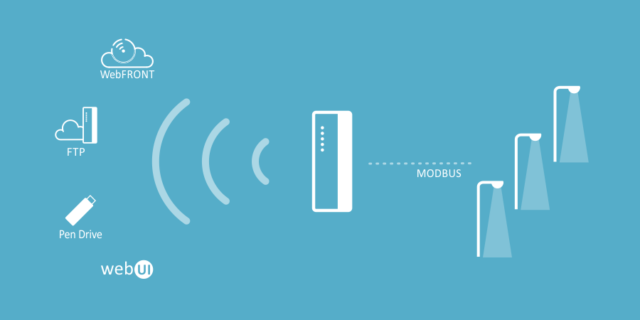
Street Light Monitoring
How it works?
Install field sensors on each lamp/cluster. Monitor and control street lights remotely via IoT Cloud platform. Dashboards & Analytical reports for energy accounting and efficiency. Get SMS/Email alerts for any faults.

Slide 16
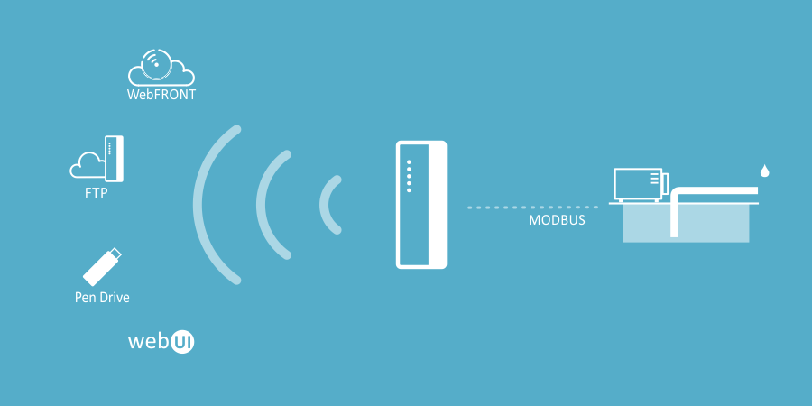
Water Treatment Monitoring
How it works?
Install field sensors to remotely collect key metrics.IoT Cloud platform for data-aggregation.Dashboards & Analytical reports.SMS/Email alerts for overflow/underflow or malfunction. Switch ON/OFF using Cloud by just one click.

Slide 17
IOT Dashboard

Slide 18
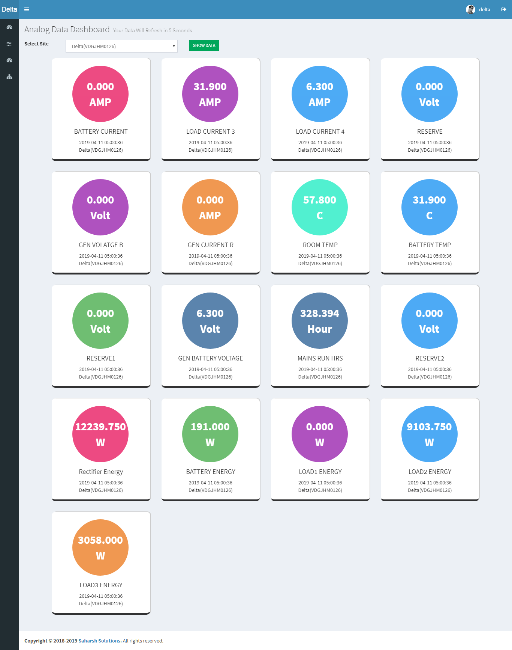
1 : Analog Data Dashboard

Slide 19
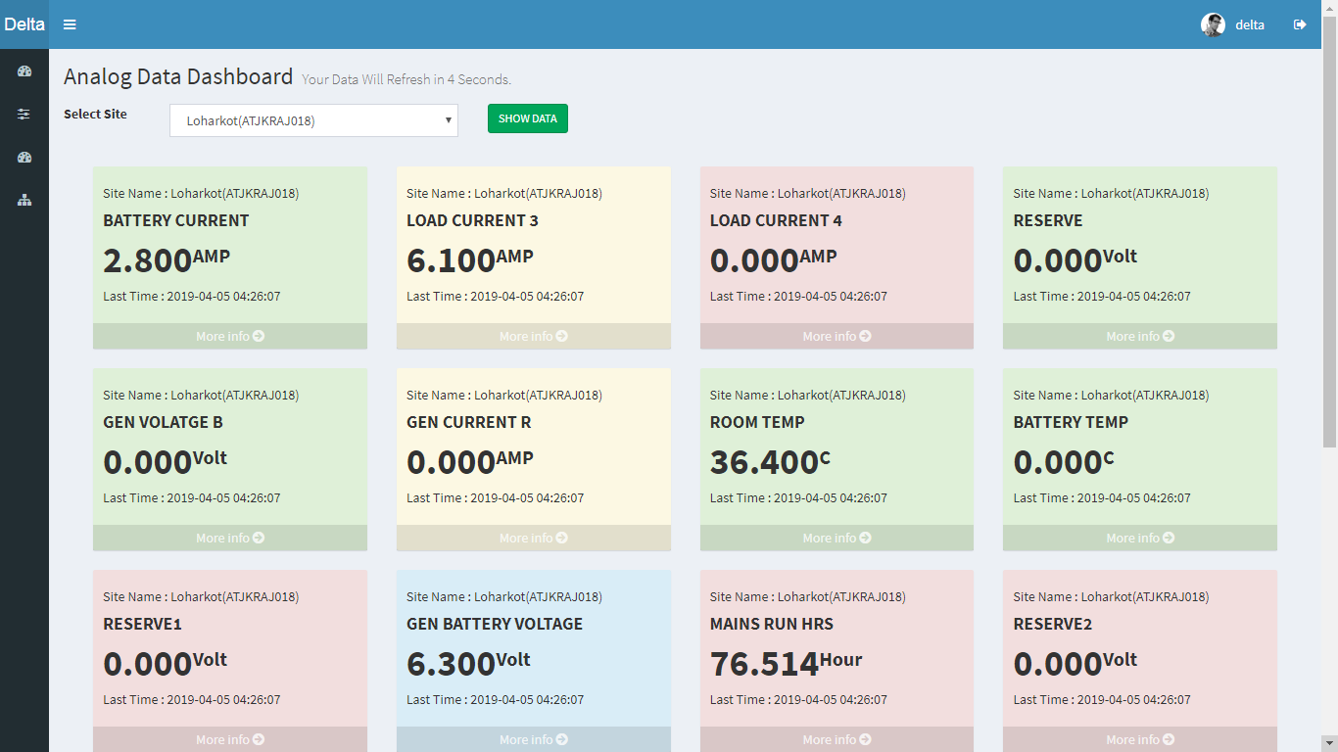
1 : Analog Data Dashboard

Slide 20
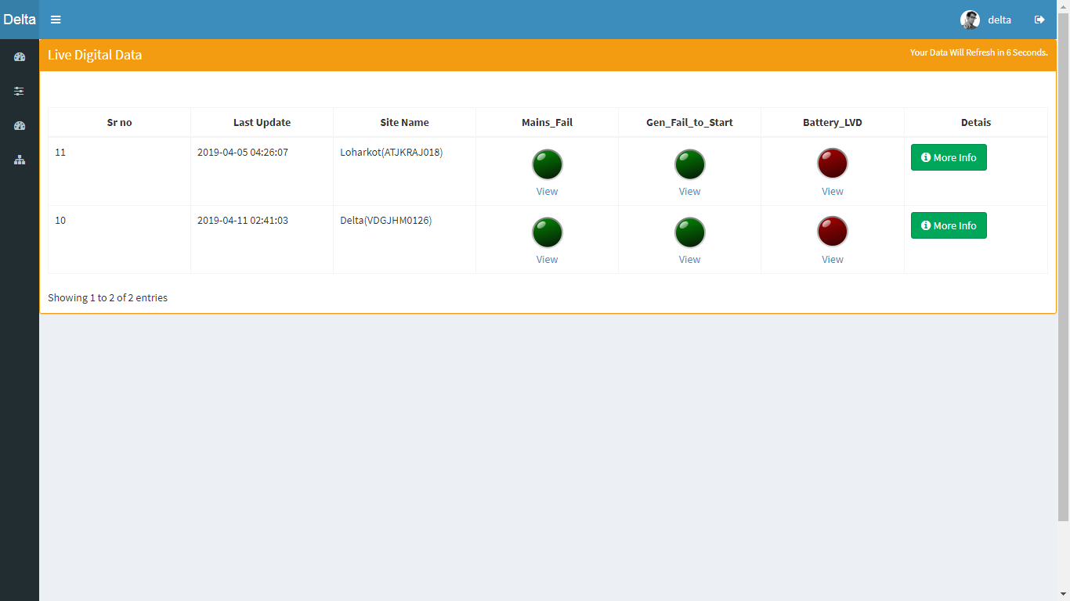
3 : Live Digital Data

Slide 21
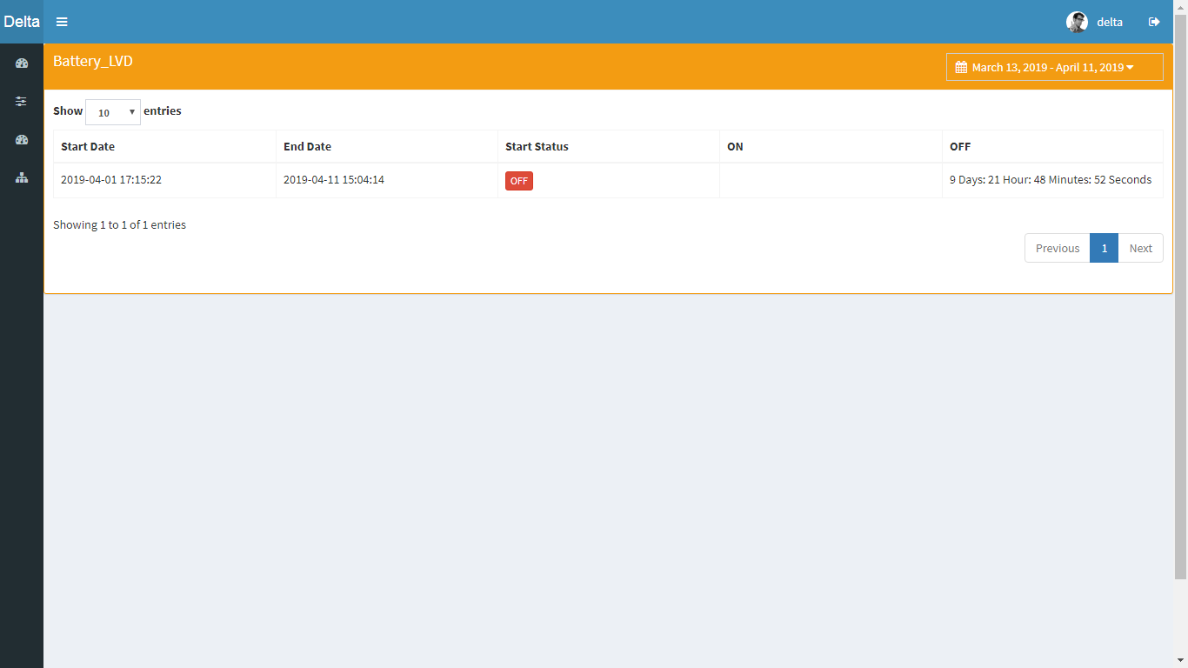
4 : Battery LVD Data

Slide 22
IOT Admin Web Panel Functions & Screenshot

Slide 23
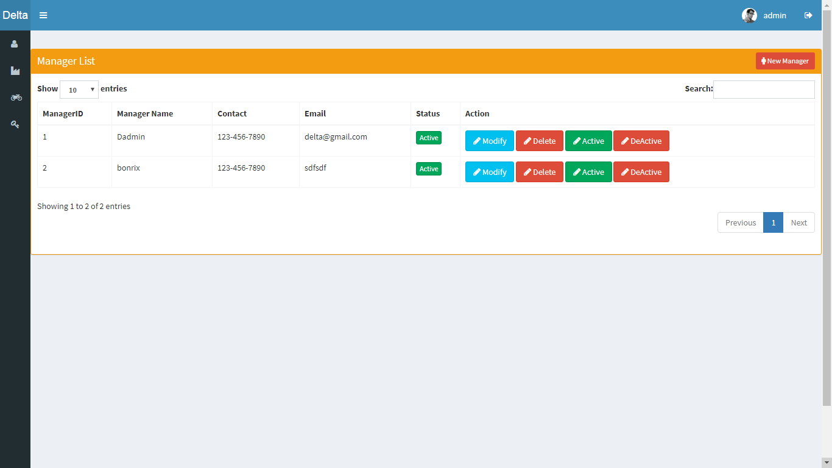
Bonrix IOT M2M System Admin Functions
1 : Manager Manage

Slide 24
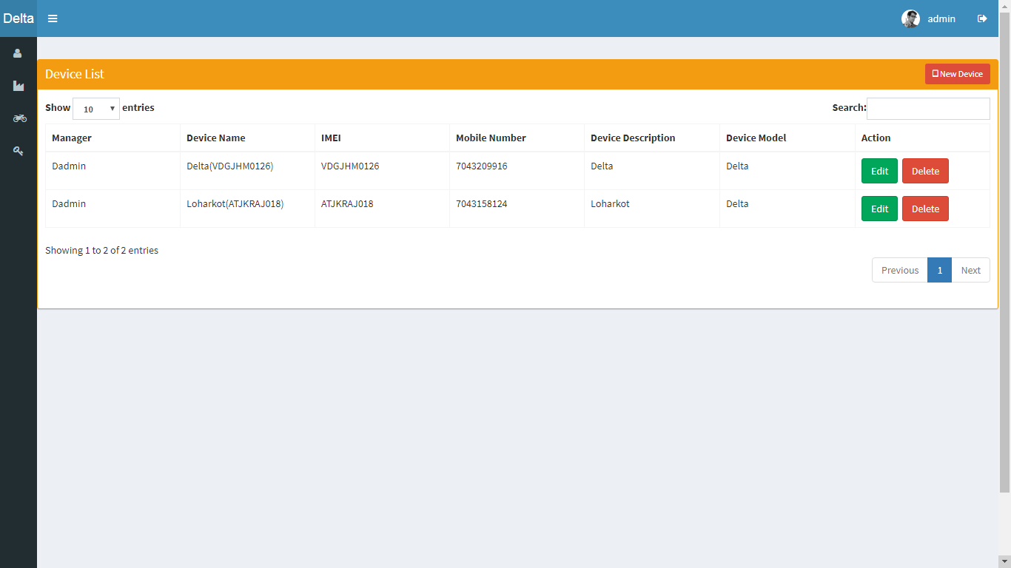
Bonrix IOT M2M System Admin Functions
2 : Device Manage

Slide 25
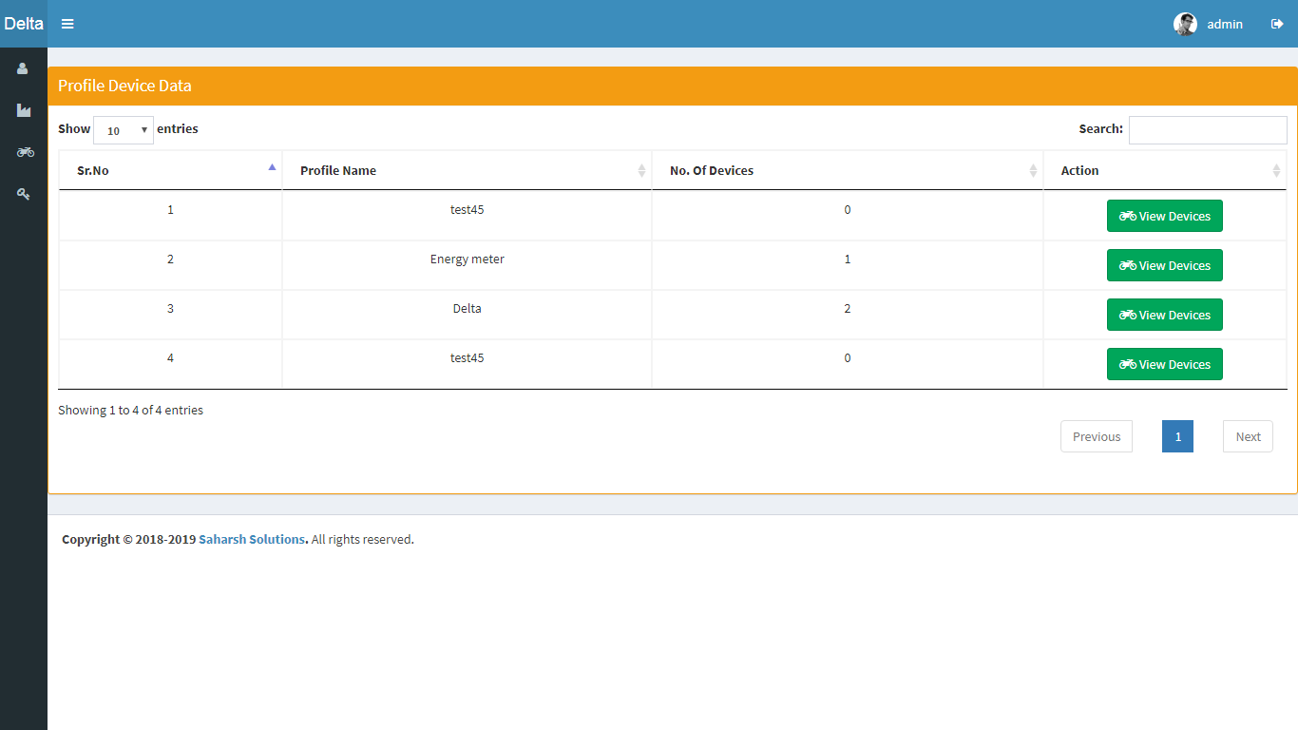
Bonrix IOT M2M System Admin Functions
3 : Device Profile

Slide 26
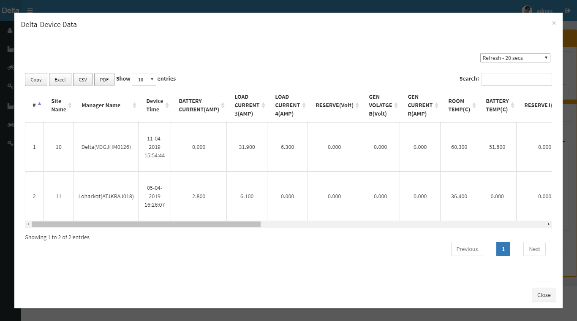
Bonrix IOT M2M System Admin Functions
4 : View Device Profile Data

Slide 27
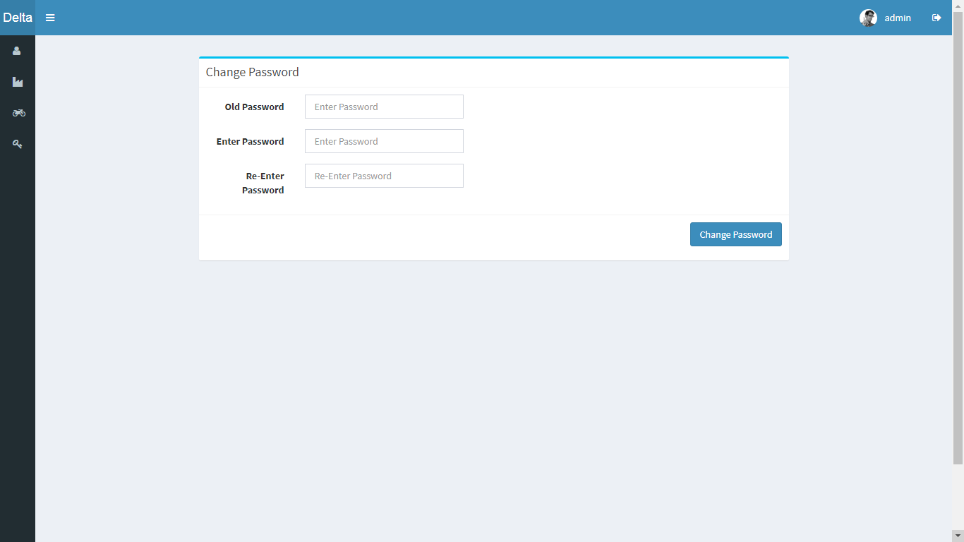
Bonrix IOT M2M System Admin Functions
5 : Password Manage

Slide 28
IOT Manager Web Panel Functions & Screenshot

Slide 29
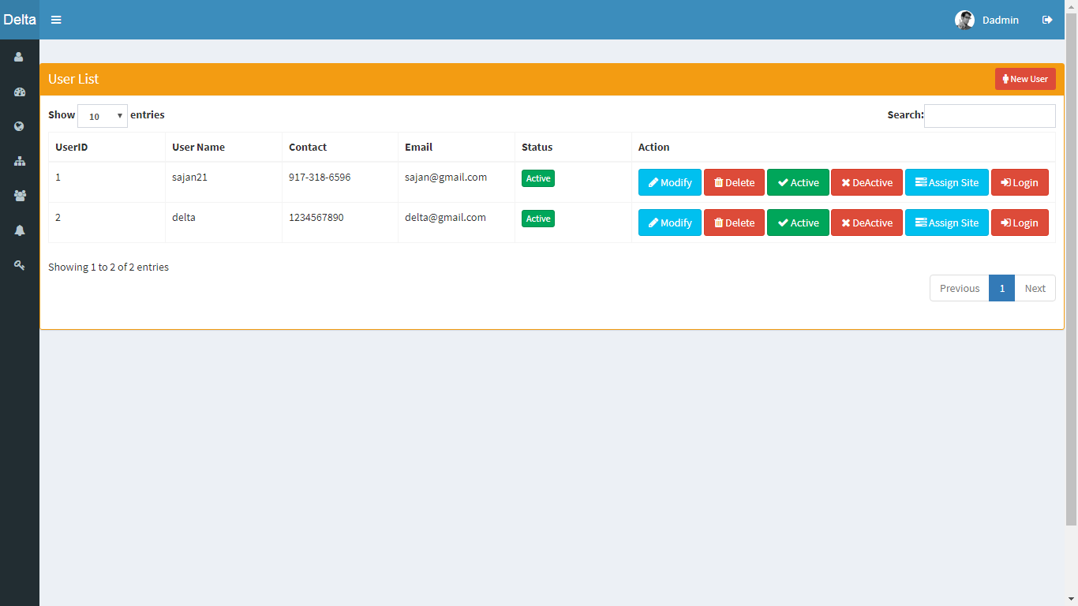
Bonrix IOT M2M System Manager Functions
1 : User Manage

Slide 30
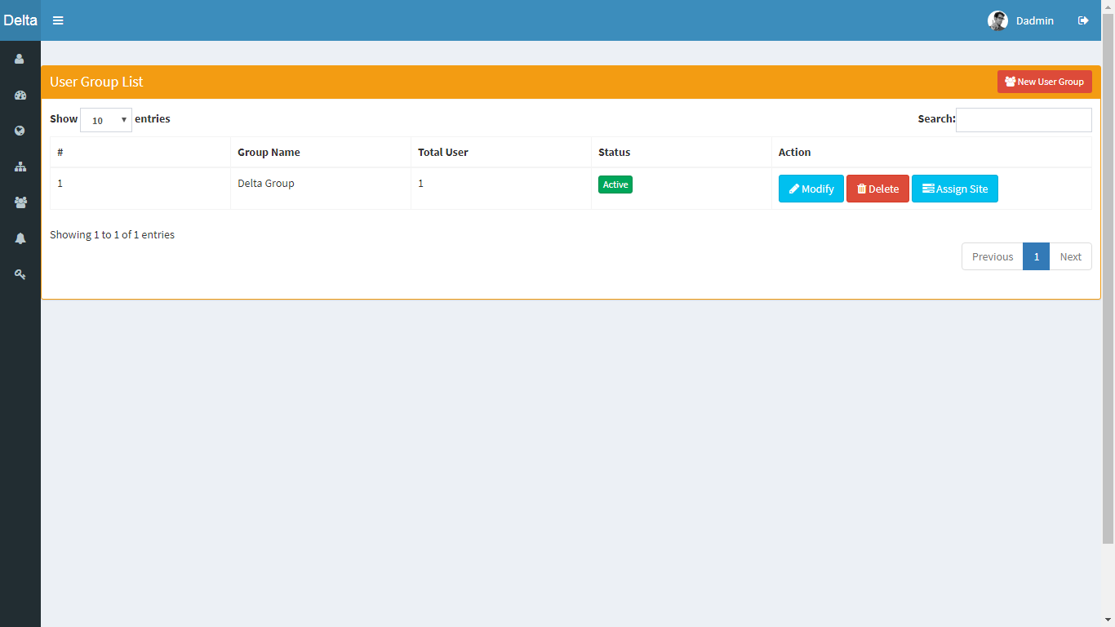
Bonrix IOT M2M System Manager Functions
2 : User Group Manage

Slide 31
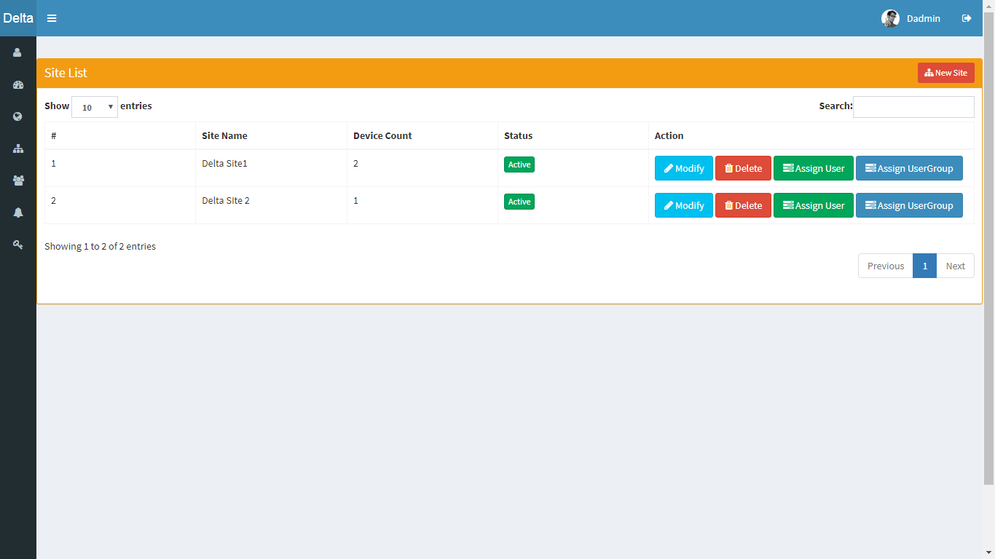
Bonrix IOT M2M System Manager Functions
3 : Site Manage

Slide 32
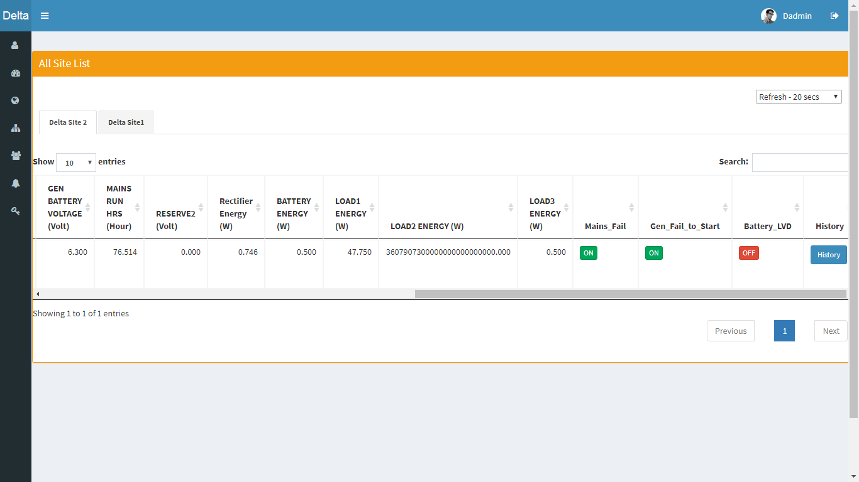
Bonrix IOT M2M System Manager Functions
4 : View Site Data

Slide 33
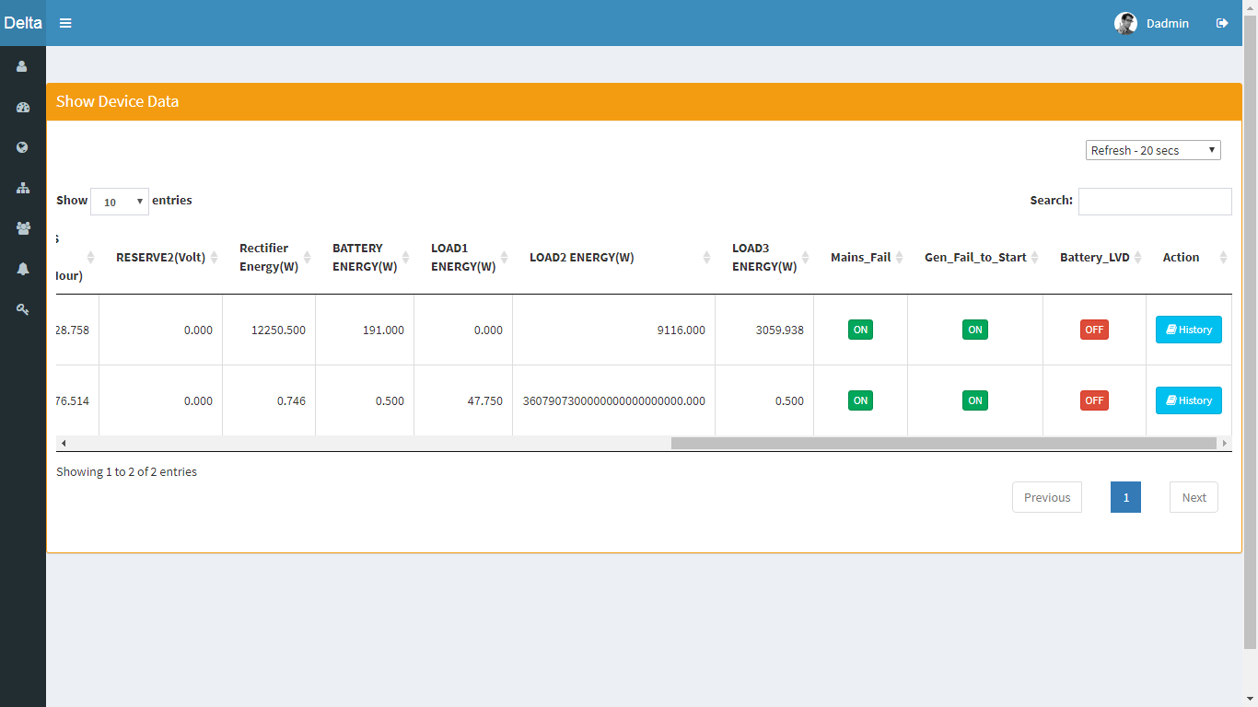
Bonrix IOT M2M System Manager Functions
5 : View Device Data

Slide 34
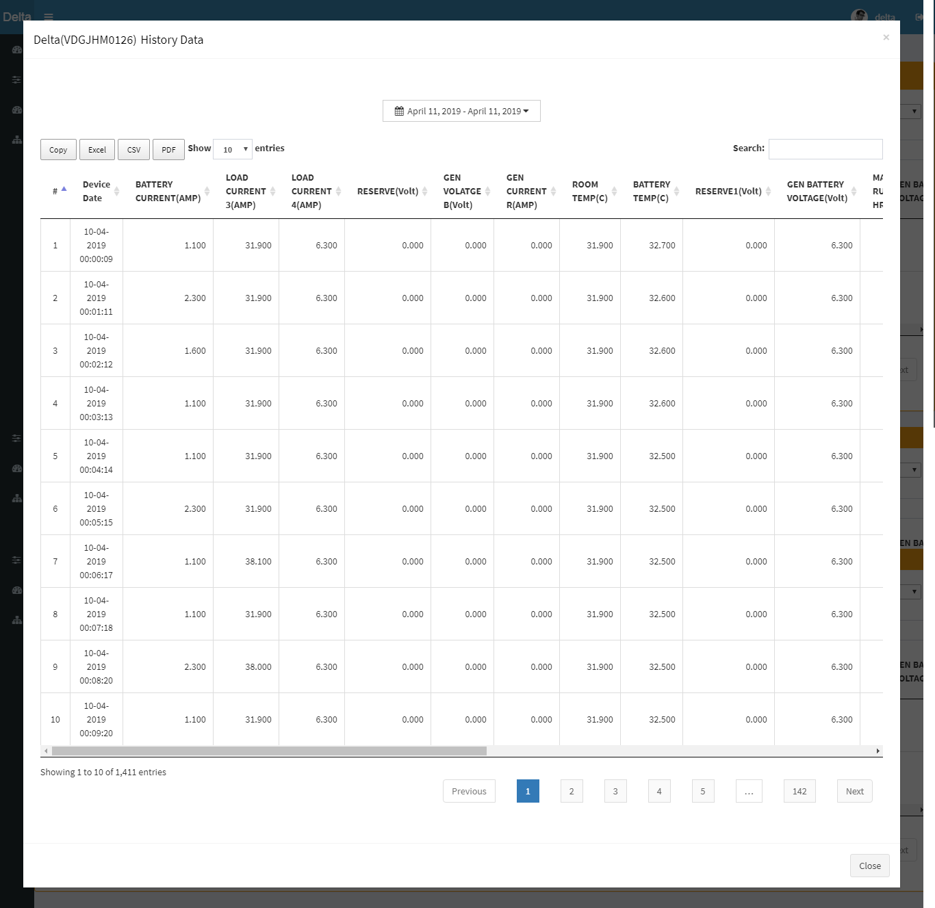
Bonrix IOT M2M System Manager Functions
6 : View Device History Data

Slide 35
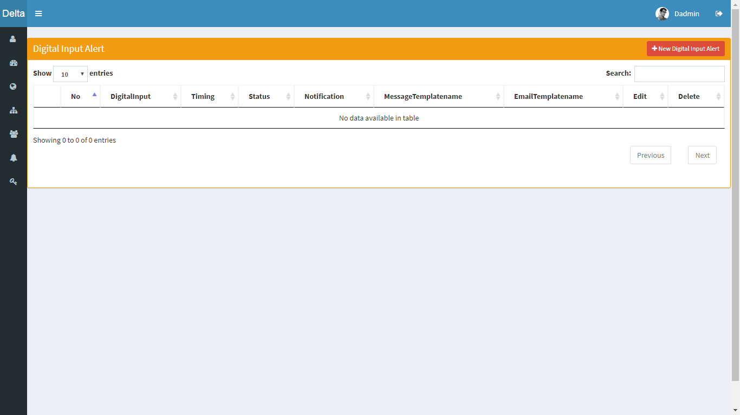
Bonrix IOT M2M System Manager Functions
7 : Digital Input Alert Manage

Slide 36
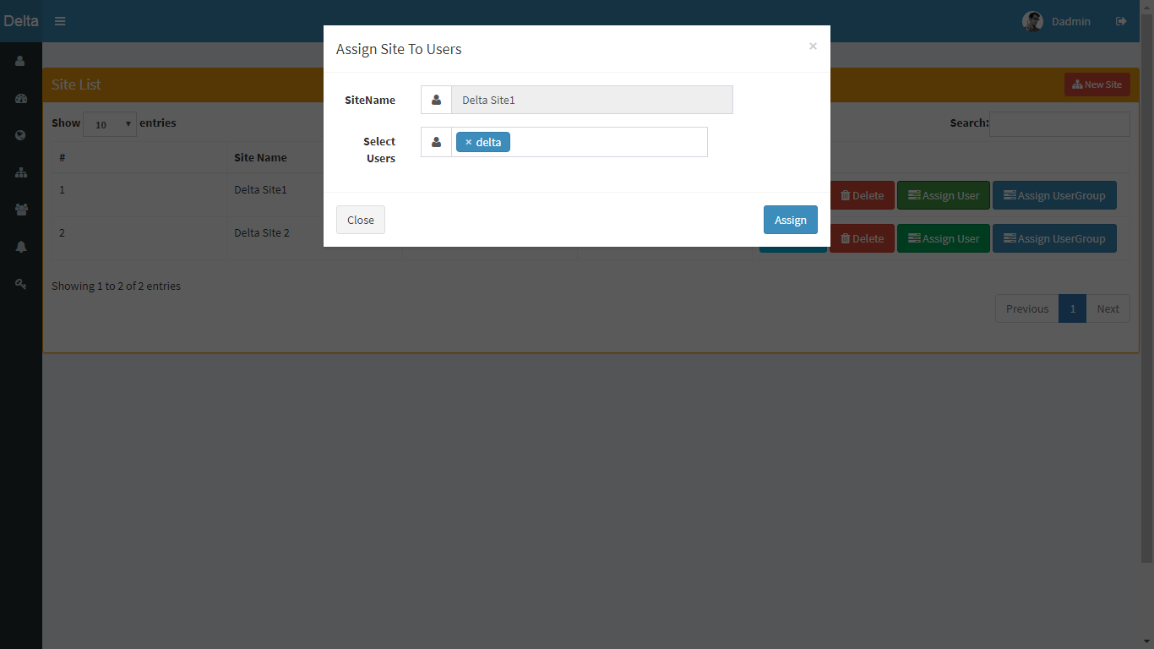
Bonrix IOT M2M System Manager Functions
8 : Assign Site To Users

Slide 37
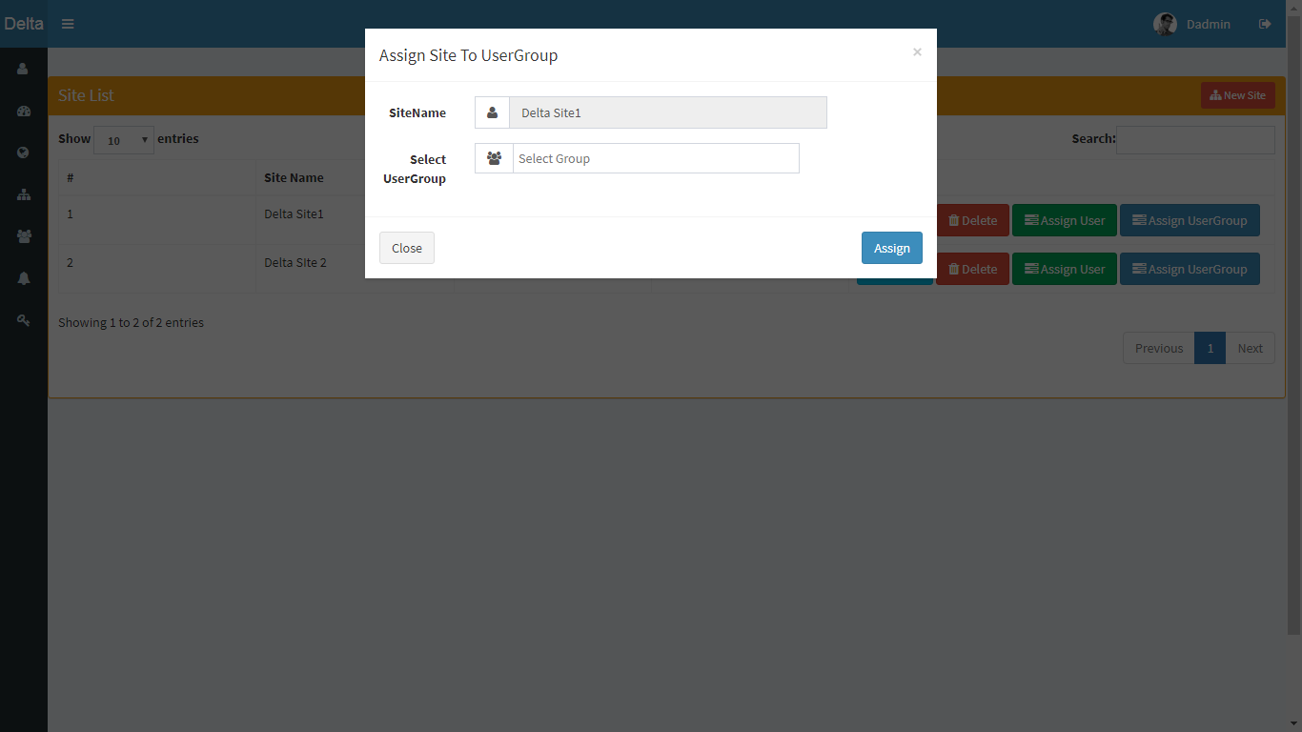
Bonrix IOT M2M System Manager Functions
9 : Assign Site To User Group

Slide 38
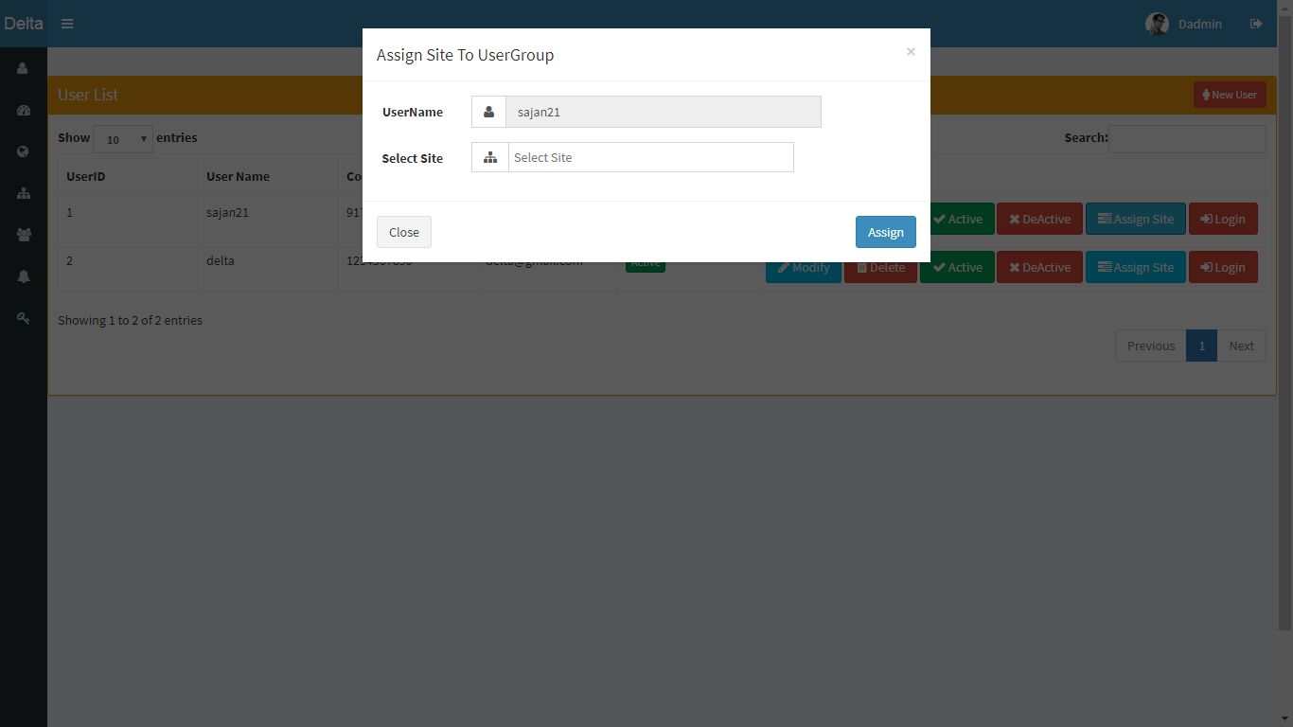
Bonrix IOT M2M System Manager Functions
10 : Assign User To Site

Slide 39
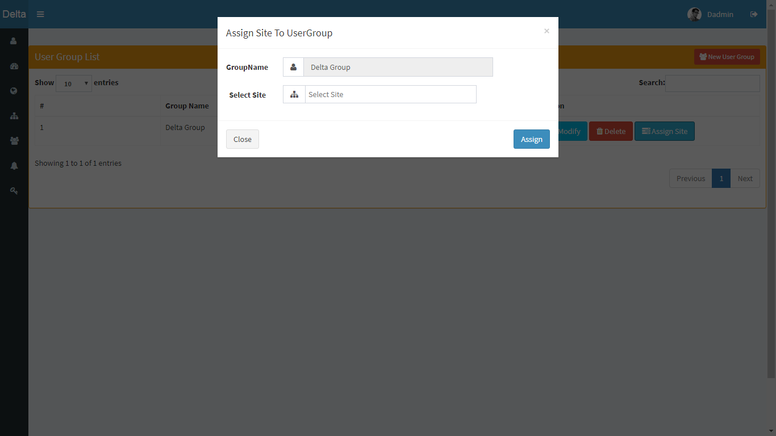
Bonrix IOT M2M System Manager Functions
11 : Assign User Group To Site

Slide 40
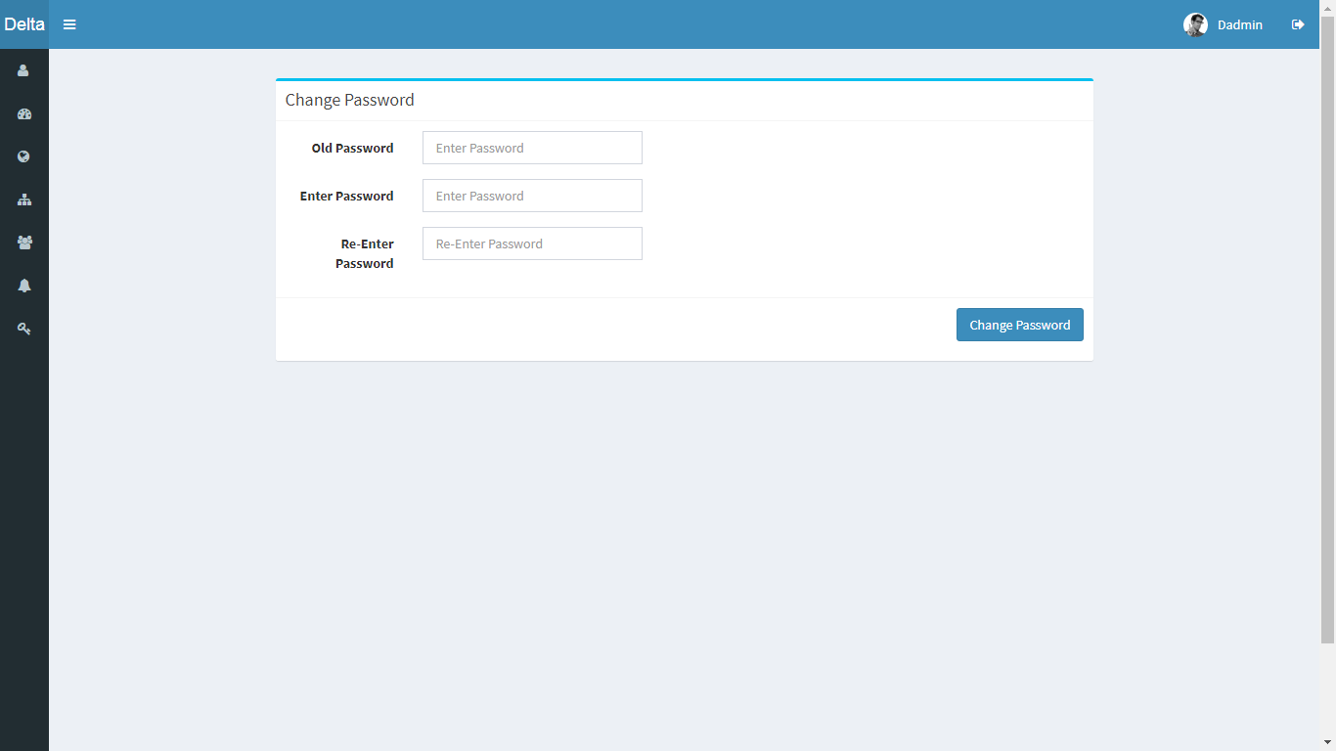
Bonrix IOT M2M System Manager Functions
12 : Password Manage

Slide 41
IOT User Web Panel
Functions & Screenshot

Slide 42
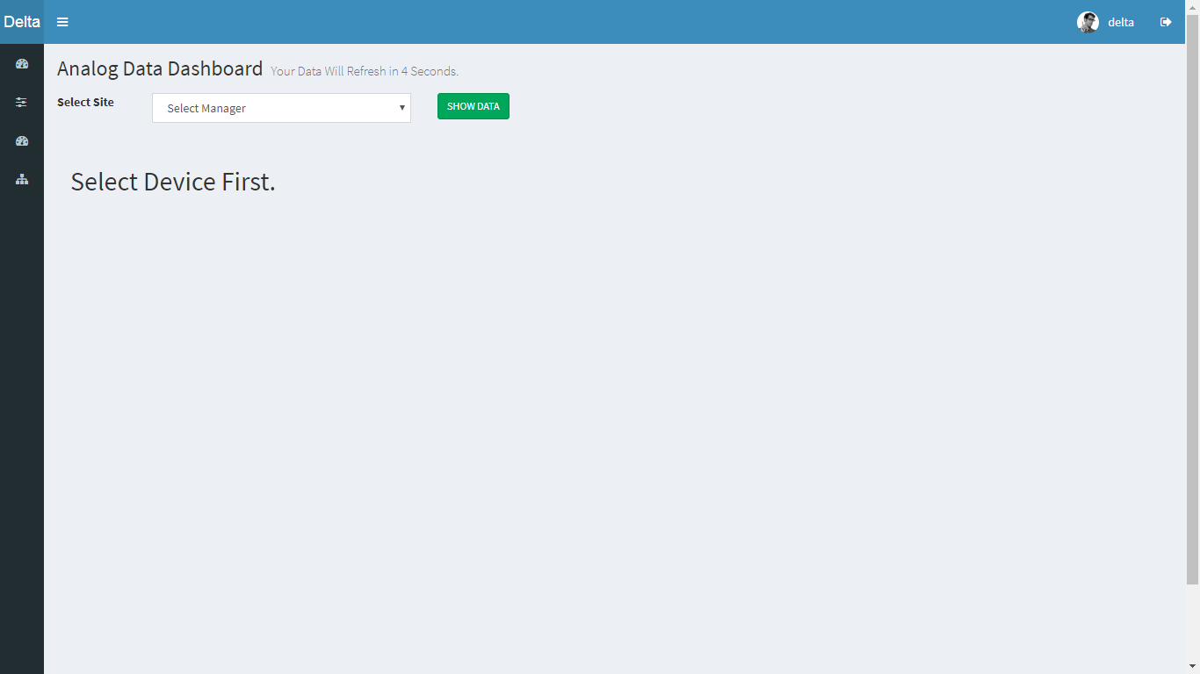
Bonrix IOT M2M System User Functions
1 : View Analog Data Dashboard

Slide 43
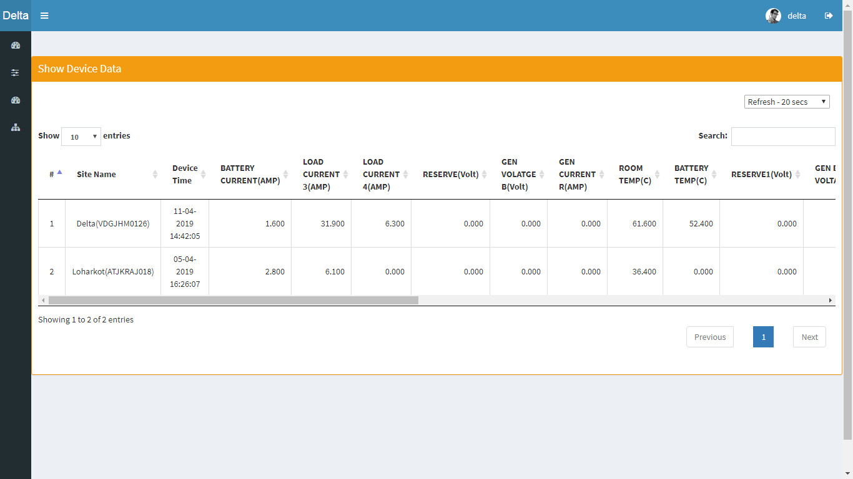
Bonrix IOT M2M System User Functions
3 : Show Device Data

Slide 44
Bonrix IOT M2M System User Functions
3.1 : Device History Data

Slide 45
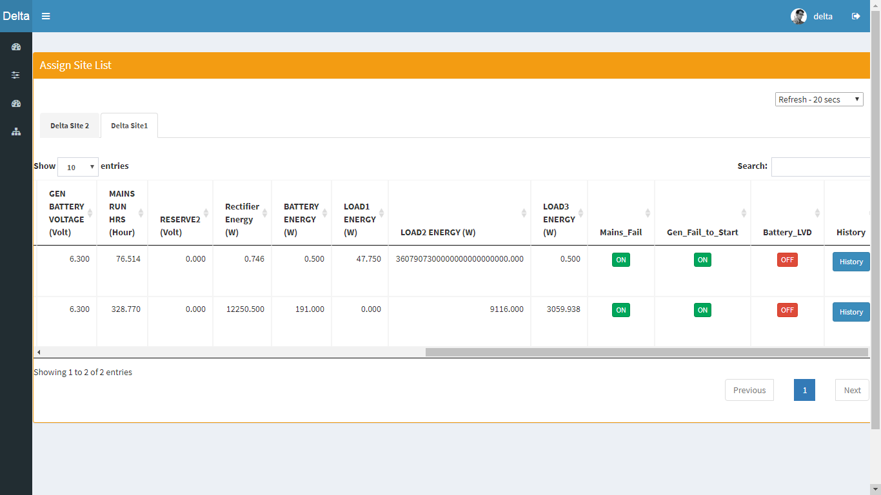
Bonrix IOT M2M System User Functions
4 : Site Data

Slide 46
Rechargesystem.bonrix.in
Beacon.Bonrix.in
gpstracker.bonrix.in
gpstracker.bonrix.in
pay.bonrix.in
crm.bonrix.in
salescloud.bonrix.in
myshoppingcart.bonrix.in
gpstracker.in
smsviamobile.com
mautodialer.com
LiveQuotes.co.in

Slide 47
mvoicecall.com
epartnerchannel.com
smsviasmpp.com
smpp2smpp.com
mandroidpos.com
callcentersoftware.co.in
tablepos.in
mconfcall.in
gpstracking.co.in
MRechargeSystem.com
mysalescloud.in
HighspeedSMS.com
DNDScrub.com
RechargeGRID.in
TwitterToolbox.in
GPSEmployeeTracking.in

Slide 48
Address :
M/S. Bonrix Software Systems
A-801, Samudra Complex,
Near Klassic Gold Hotel, Off. C. G. Road, Navrangpura,
Ahmedabad - 380009, Gujarat, India.
Contact NO :
+91-9429045500,9426045500
Website:
http://www.bonrix.net/ & http://www.bonrix.co.in/ & http://iot.bonrix.in/
Email Id:
bonrix@gmail.com

